Slide 1
Thesis
Data Visualization

Slide 2
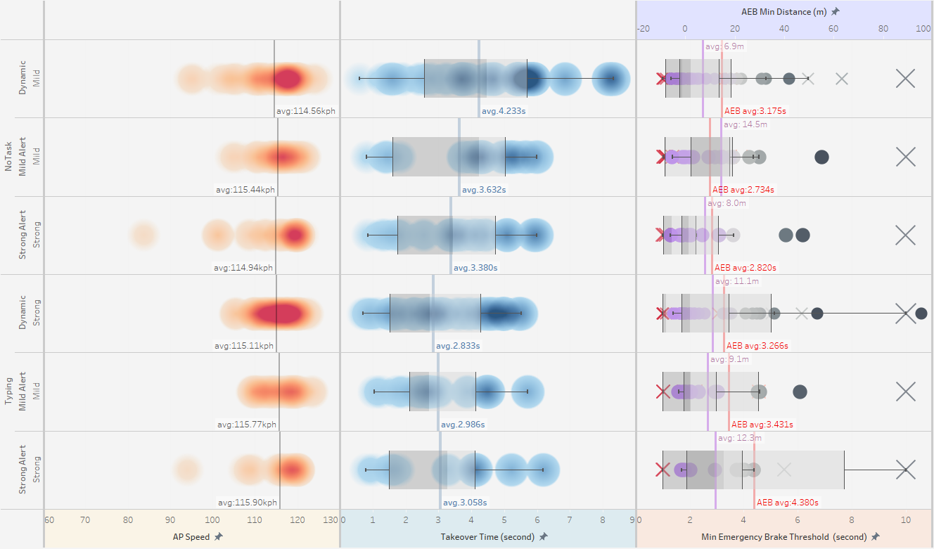
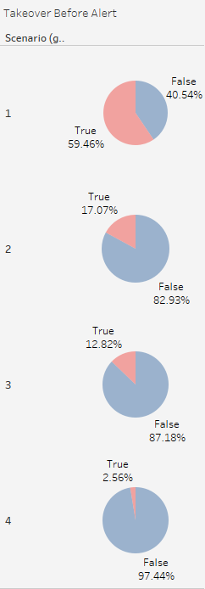
Takeover Safety (All)
Strong alert performs better to get driver’s attention to takeover sooner
Participants tends to takeover faster when they’re on the phone

Slide 3
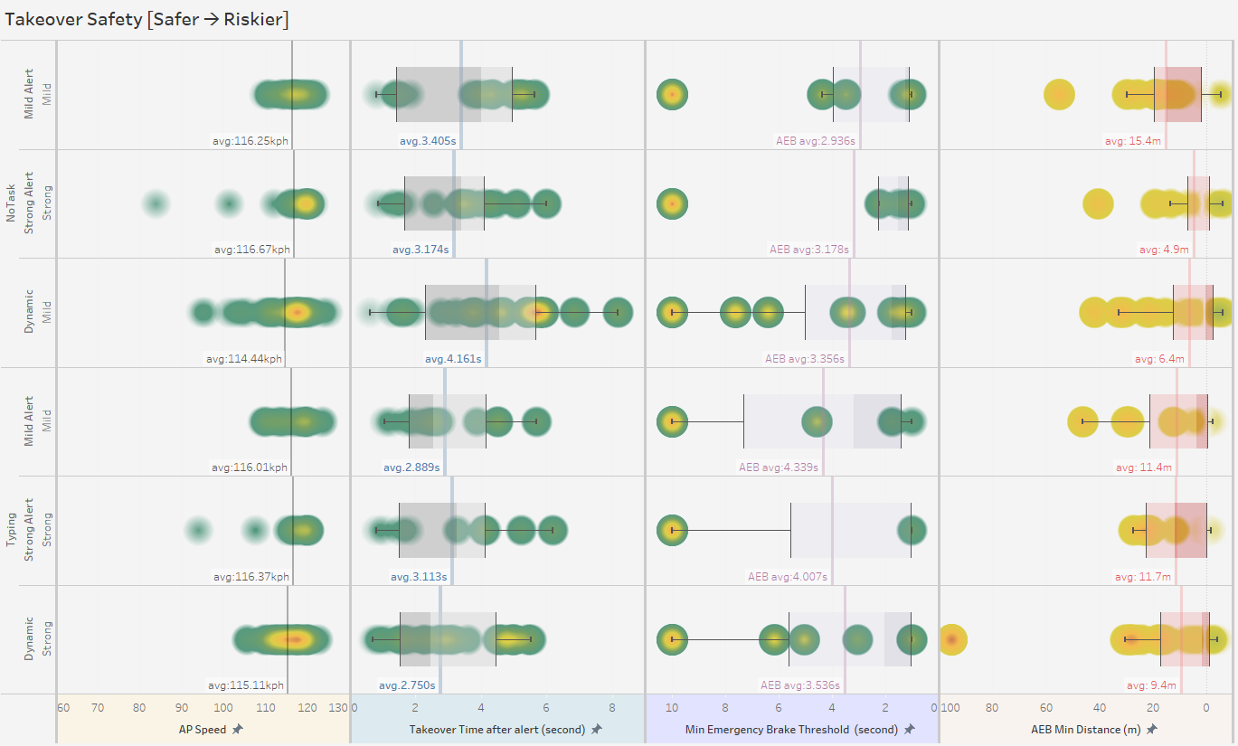

Slide 4
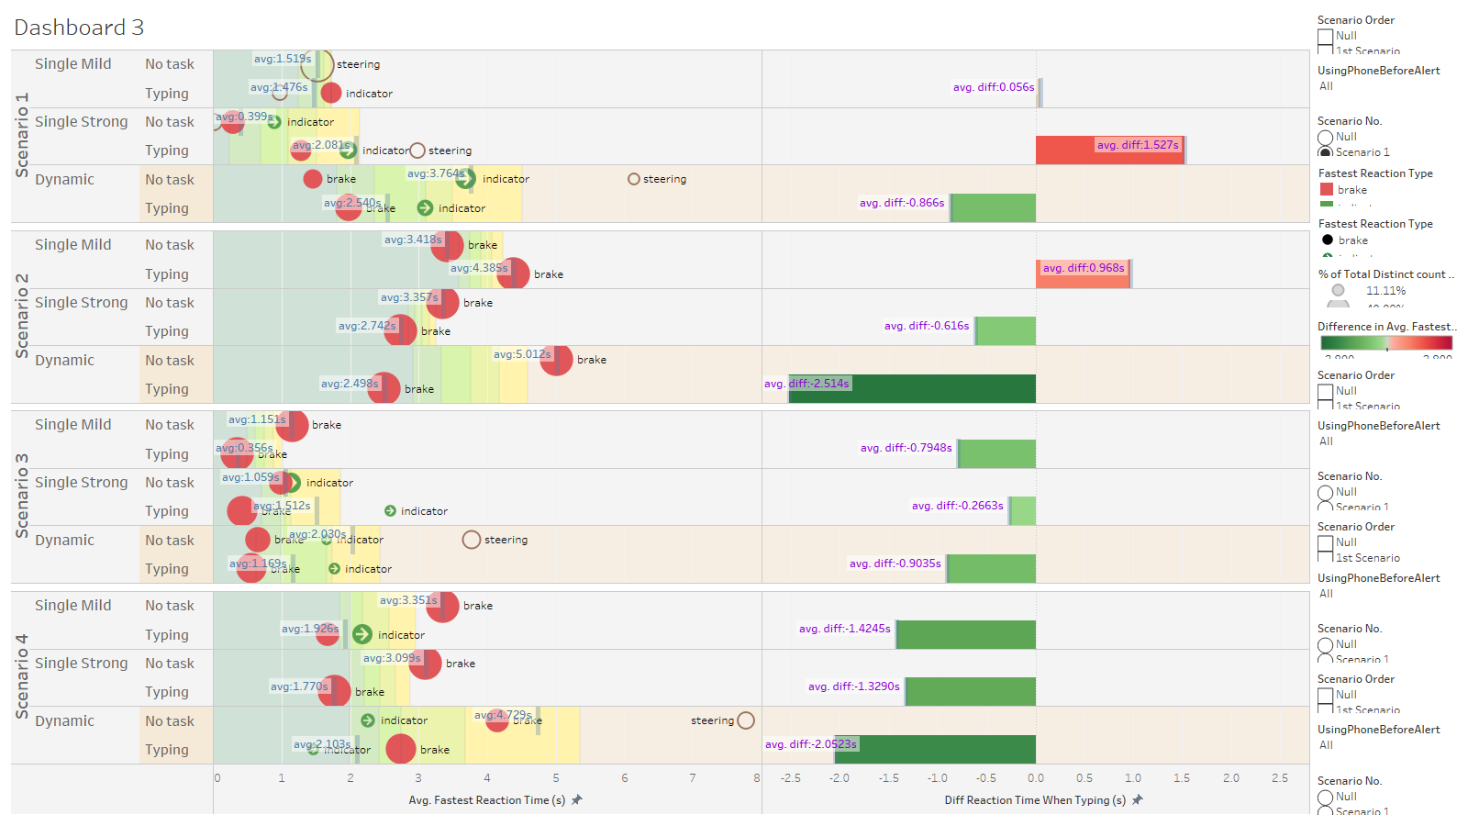

Slide 5
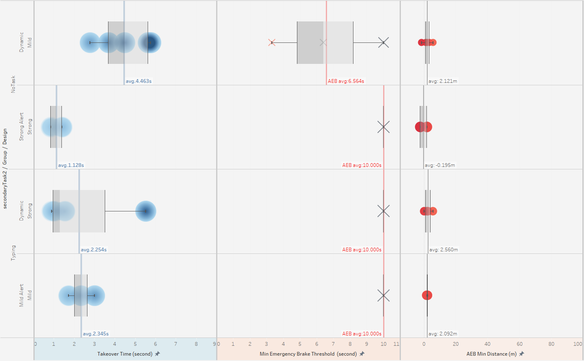
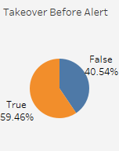
Takeover Safety – Scenario 1
Static road closure (construction zone) in the front on left lanes (@110-120 kph on 2nd lane)
[visible ahead before alert, alert at 300m to crash → 9-9.8s to frontal crash, 7.5-8s to safely stop]
Visible static hazard ahead results in higher takeover before alert.
Strong alert performs better to draw driver’s attention to takeover sooner

Slide 6
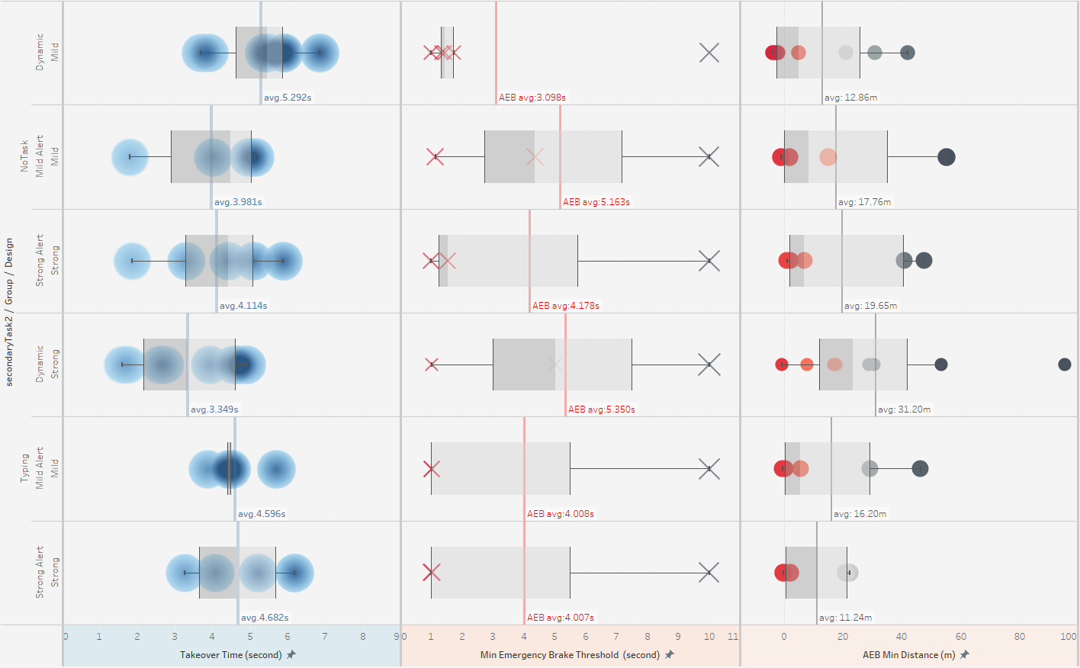
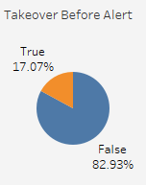
Takeover Safety – Scenario 2
Leading vehicle Emergency braking due to animal appeared on the road ahead (@110-120 kph on 2nd lane)
(start braking at 200m → 6-6.5s to start braking, full stop before 300m → 8-9s to frontal crash)

Slide 7
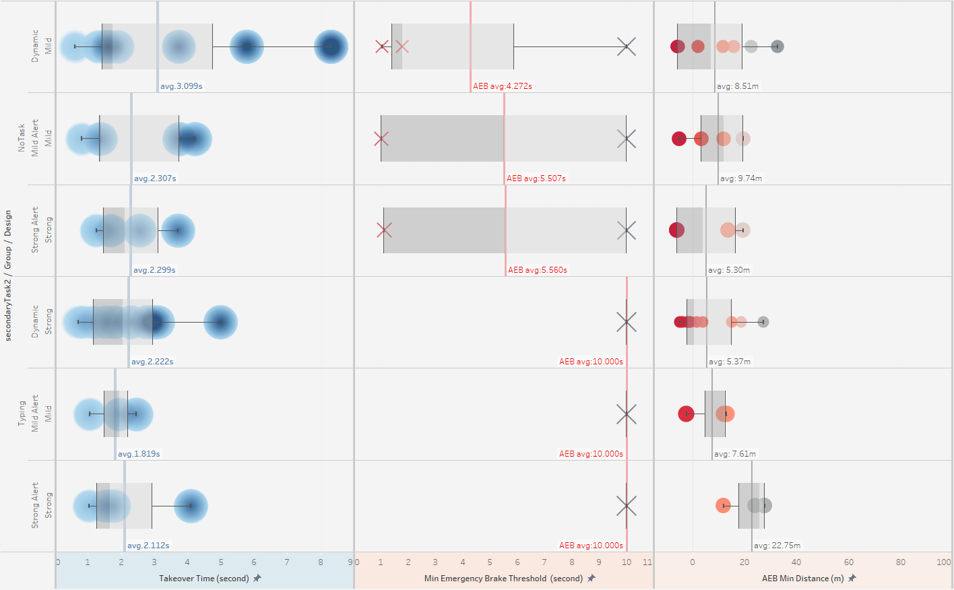
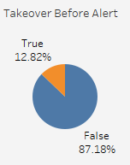
Takeover Safety – Scenario 3
Sudden lane change cutting in the front from right lane (@110-120 kph on 2nd lane)
[Initiate lane change and alert at 40 m behind cut-off vehicle driving at 90 km/h → 5.4-8.1s to frontal crash]

Slide 8
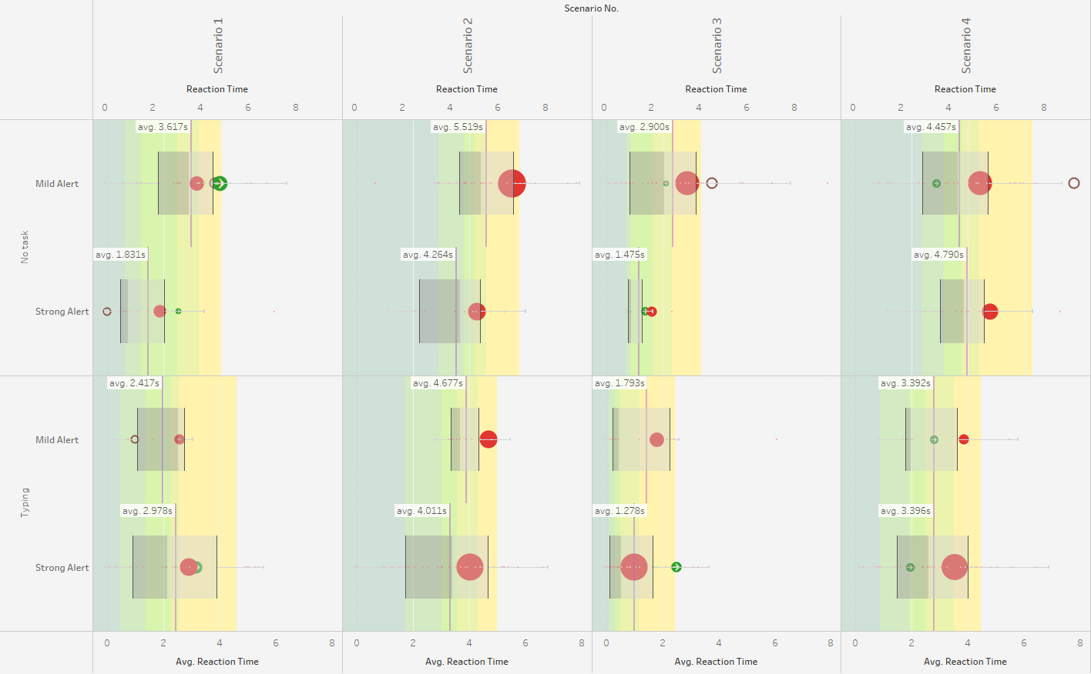

Takeover Safety – Takeover Reactions

Slide 9
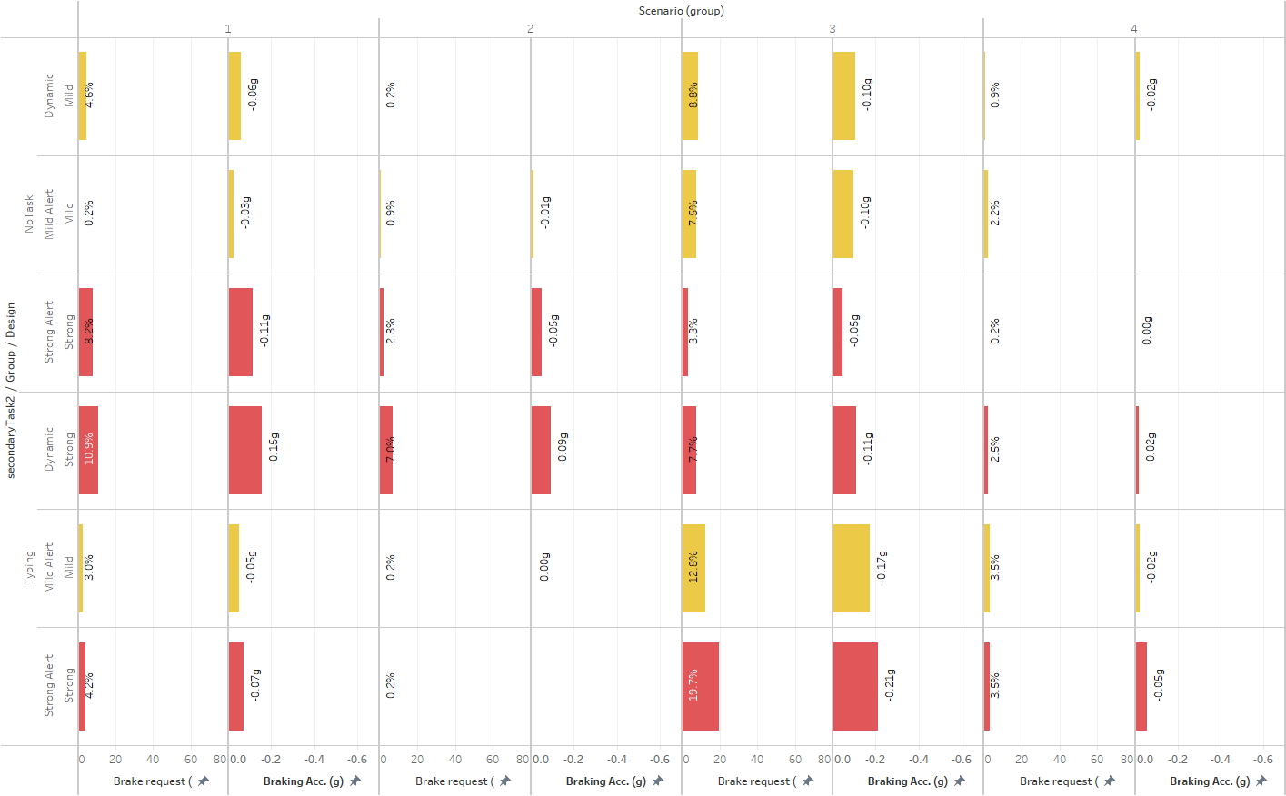
T = 0-3s
Dynamic stronger alert initiate braking sooner in scenario 1&2
Strong alert induced harder brake

Slide 10
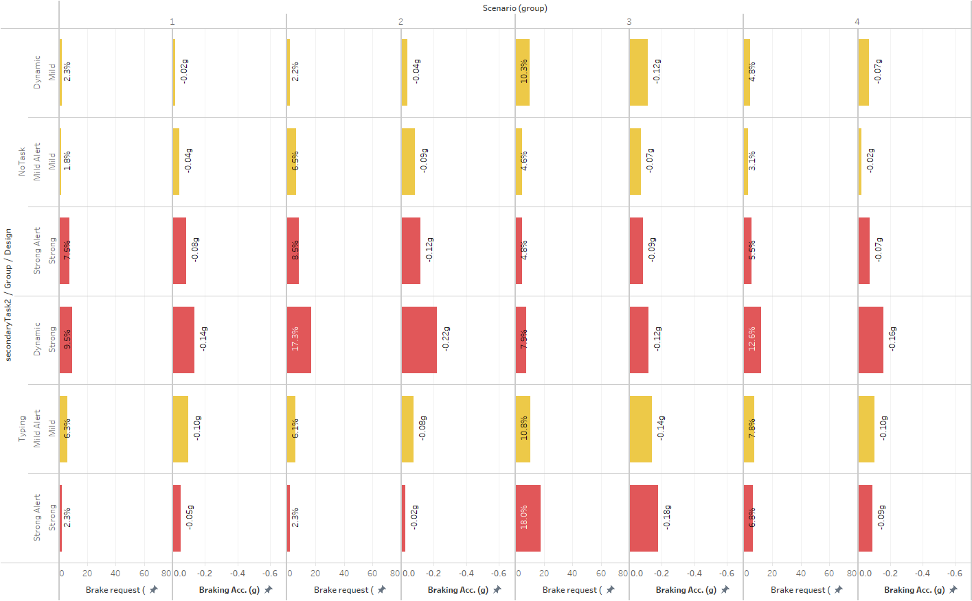
T = 2-5s

Slide 11
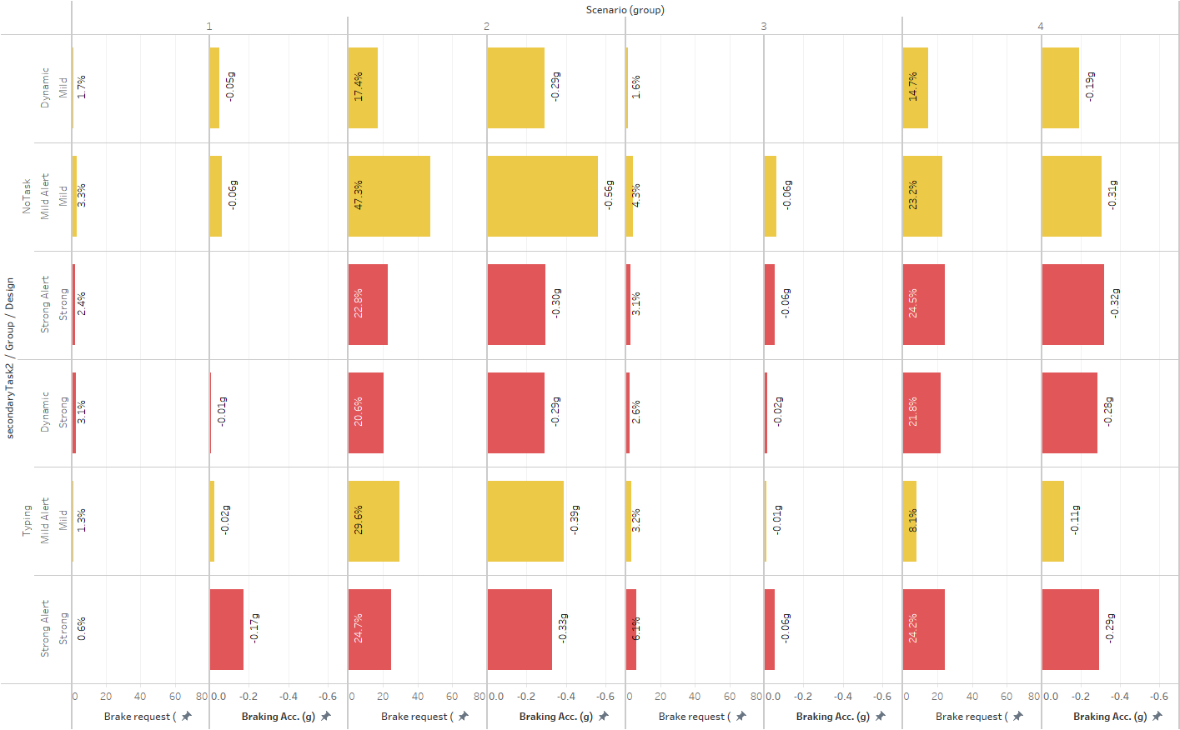
T = 4-7s

Slide 12
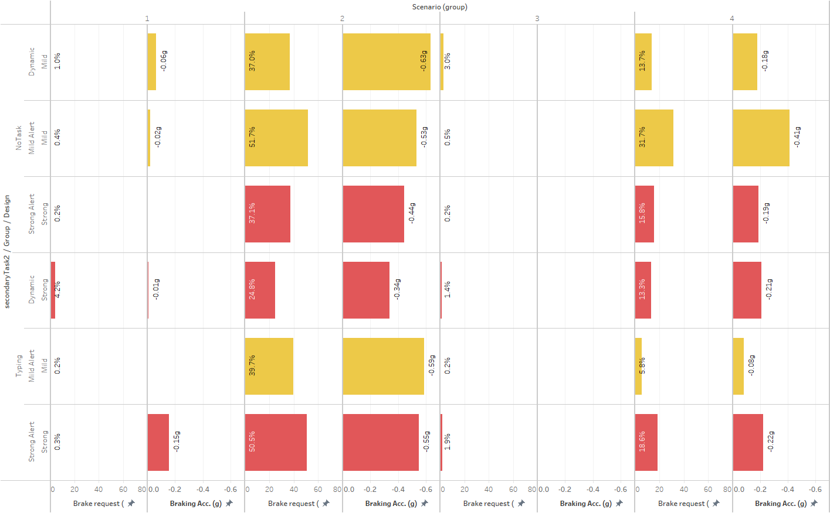
T = 6-9s

Slide 13
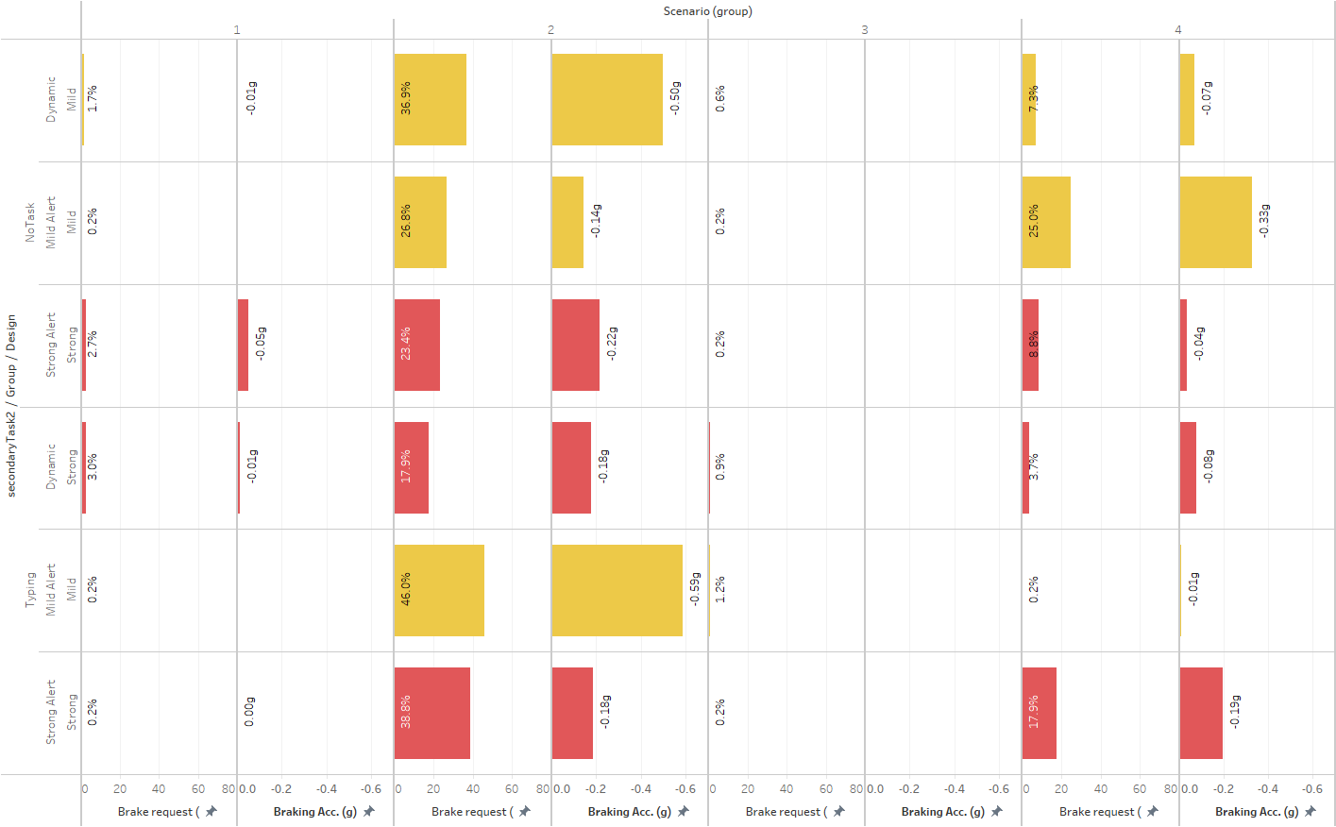
T = 8-11s

Slide 14
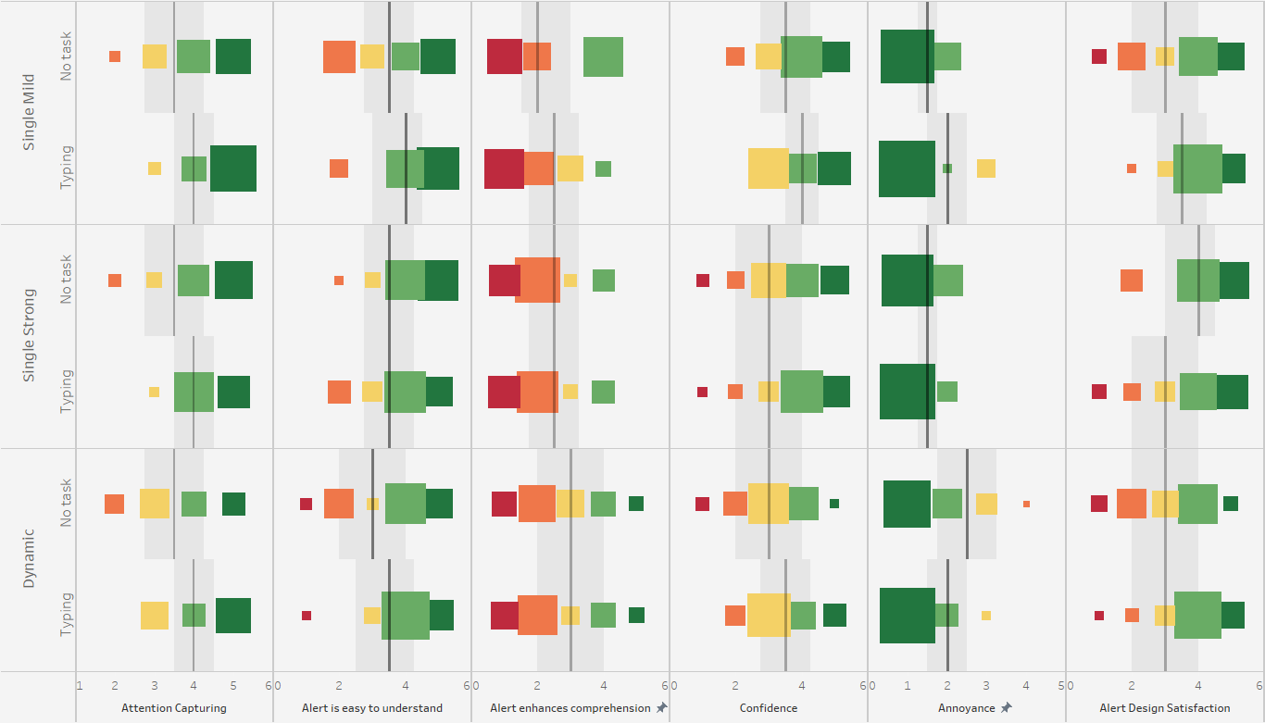

Slide 15
